Slide 1

Regional Heating Network (RHN) – Graph model

Slide 2

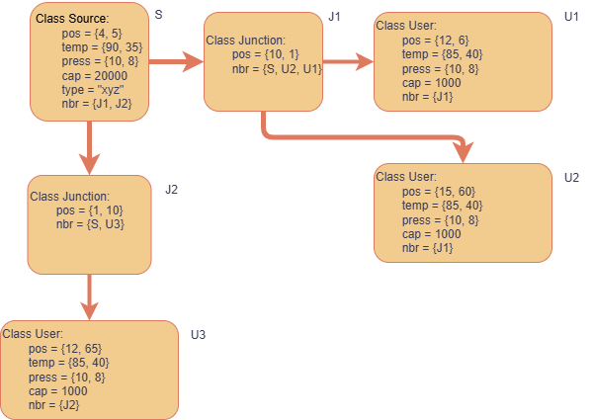
Solution approach
Modelling every node as an object allows the programmer to scale the model later on with ease!
Every junction is now modelled as a graph node, with some defined properties and a set of neighbours!

Slide 3
Use of BFS while building connections
J1
S
What if we have multiple ways to reach a user?
How to reach node U2?
U1
Possible paths? S → J1 →J2 → U2 and S → J3 → U2
Choose the second
Reason?
The second path supplies it before the first one
J3
J2
Hence, build model using the path S → J3 → U2
U3
U2

Slide 4

Assumptions of our current model
Assuming negligible losses while traveling through pipes, the entire temperature and pressure drop occurs only at the source and sink.
The maximum safe mass flow rate is determined based on a 50 K temperature drop.
Any increase in demand is managed by either raising the source supply temperature or introducing high-temperature water from the storage tank.
Throughout this process, care is taken to ensure that the mass flow rates in each pipe do not exceed their maximum capacity.

Slide 5
Dry Run of building a network
Source (S)
Junction (J1)
User (U1)
Junction (J2)
User (U2)
Consider the Excel Data:
-- Single heater, 2 junctions, 3 sinks
-- Source connected to the 2 junctions
-- Junctions connected to users
-- One of the junctions connected to 2 users
User (U3)

Slide 6
Algorithm
Source (S)
Junction (J1)
User (U1)
Consider U1
-- Demand = 10 kW
-- Max mass demand flow rate = 10 kg/s
Junction (J2)
User (U2)
Consider U2
-- Demand = 15 kW
-- Max mass demand flow rate = 20 kg/s
User (U3)
How do we get the mass flow through junction J1, and temperature at J1?

Slide 7
Algorithm
T_{r} = 308 K
T_{r} = 308 K
Source (S)
Junction (J1)
User (U1)
Consider U1
-- Demand = 100 kW
-- Max mass demand flow rate = 10 kg/s
T_{J1} = ? K
T_{S1} = ? K
-- Start off by defining return temperature, T_{r} = 308 K
-- Assume the network is operating at max load, or take mass flow rate, m_{W1} = 10 kg/s and m_{W2} = 20 kg/s
-- Gives us supply temperature, T_{S1} = 331.81 K and T_{S2} = 342.71 K
-- Since at a given instant, J1 will have only one temperature defined, we have to choose on out of 331.8 K and 343.71 K
Junction (J2)
User (U2)
T_{S2} = ? K
T = 308 K
Consider U2
-- Demand = 150 kW
-- Max mass demand flow rate = 20 kg/s
User (U3)

Slide 8
Algorithm
T_{r} = 308 K
T_{r} = 308 K
Source (S)
Junction (J1)
User (U1)
Consider U1
-- Demand = 100 kW
-- Max mass demand flow rate = 10 kg/s
T_{J1} = 343.71 K
T_{S1} = 343.71 K
-- Taking the greater of the two, ensures a reduction in load on the system, or clearly the mass flow rate falls for any one of the sink, however the demand is successfully met. Hence T_{J1} = 343.71 K
-- Cascading this entire calculation, int the similar manner we can obtain the mass flow rates and temperatures at every junction!
Junction (J2)
User (U2)
T_{S2} = 343.71 K
T = 308 K
Consider U2
-- Demand = 150 kW
-- Max mass demand flow rate = 20 kg/s
User (U3)

